Slide 1
Software Engineering Approach to Human-Computer-Interaction
Chapter 6 Interaction Design

Slide 2
Contents
6.1 Design Framework
6.2 Design Techniques and Rules
6.3 Design Details

Slide 3

6.3 Design Details-3
Designing for the Web
Notes:
Designing for the Web

Slide 4
Designing for the Web
Page-Based Interactions
The Mobile Web

Slide 5
Page-Based Interactions
The fundamental character of the medium that is the web is shaped in a huge way by the concept of the page.
From its inception, the whole technology stack has been formed around pages.
Native applications are usually constructed in terms of screens or views.
Although they are analogous to the page, there are some meaningful and important differences between the two ways of structuring an experience.

Slide 6
Navigation and wayfinding
A native application usually has a limited number of spaces or modes that the user can be in, and different pieces of content can populate each of those spaces or modes.
On the web, each piece of content typically has its own place (or, rather, URL), and the trick is figuring out how to help people get to the content they want.

Slide 7
Navigation and wayfinding
This leads us to the field of information architecture.
How to organize and structure content across pages in a meaningful way.

Slide 8
Primary navigation
Primary navigation has signified how the user gets to the major areas or sections of a website or application.
Top navigation is a superior approach in most cases.
Side navigation makes the page crowded and occupies the page’s visual entry point, forcing the user to scan past it to read content.
The biggest limitation of top navigation—that it can accommodate only a few items of limited length—may actually be one of its greatest benefits.

Slide 9
Primary navigation
Left-side navigation is better
If you have a large heterogeneous content space, reducing to items that can fit on a horizontal bar can result in navigation terms that are meaninglessly abstract to your users.
They are left-aligned.

Slide 10
Primary navigation

Slide 11
Primary navigation
An important topic in web design:
dynamically hiding and showing navigation controls that depend on the user’s location in the system, and even where he or she is on a page.

Slide 12
Primary navigation
Design principle
Use persistent headers to maintain context.

Slide 13
Secondary navigation and beyond
Often the entire information space of an application (or suite of applications) cannot be meaningfully navigated to from a handful of top-level links.
The content may bear secondary levels of persistent navigation, and perhaps additional levels beyond that.
Expert users of sovereign applications may be able to memorize navigation paths three or more layers deep.
most intermediate or novice users struggle to find information if it’s buried in a three-level hierarchy.

Slide 14
Secondary navigation and beyond
It’s best to try to keep your navigation space as flat and compact as possible to make it easier for users to create a useful mental model of how your application is organized.

Slide 15
Secondary navigation and beyond
Several basic yet effective mechanisms for secondary and additional levels of navigation.
add a left-hand menu or a second stripe of horizontal navigation links.
fat navigation
Provide persistent feedback about where he or she currently is.
Visual feedback in the navigation elements themselves
Breadcrumbs
Breadcrumbs with lateral links help speed navigation.

Slide 16
Secondary navigation and beyond

Slide 17
Secondary navigation and beyond

Slide 18
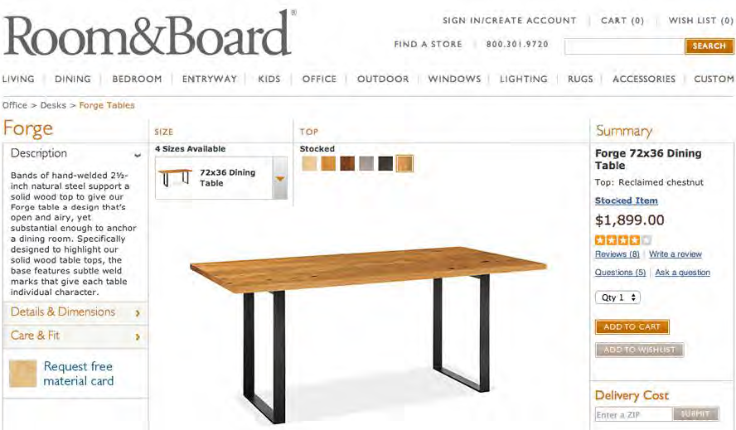
Secondary navigation and beyond

Slide 19
Content navigation
Content such as photos and articles.
They are numerous and subject to change
The relationships between them often are associative, rather than strictly linear or hierarchical.

Slide 20
Content navigation
Most commonly, items are presented in listings of some sort
Because some items may be newer, more important, or more likely to be interesting to the audience, it’s also useful to highlight featured content.
by using more prominent typography,
by changing the size and position on the page,
by using a carousel that cycles through features in a more visual format.

Slide 21
Content navigation
Content can be organized in multiple ways
by topic, author, or date published…
expose multiple navigation schemes to browse content
make use of the faceted search techniques

Slide 22
Searching
Is one of the most important navigation methods on the web.
Most people are not very good at forming queries to find what they’re looking for.
One of the most successful innovations in searching has been auto-complete, also known as type ahead.

Slide 23
Searching
Disambiguation, or auto-suggest is another tool Google has normalized as part of searching.

Slide 24
Searching
Faceted search
which allows users to specify the attributes of the item they are looking for

Slide 25
Searching
Categorized suggestions is yet another method of speeding the user to relevant results when a search term is applicable across many different categories or domains.

Slide 26
Scrolling
One of the most obvious yet significant features of the page-based web experience is the prevalence of scrolling.
It is almost always good design in a native application to have key functions persistently available.
With web experiences, on the other hand, critical information and functions often must be accessed through scrolling.

Slide 27
Scrolling
One method is to create an effective visual rhythm through the use of white space and a strong typography system.
You also should be generous with font and control sizes to You also should be generous with font and control sizes to
improve usability for touch users and to improve scanability when the user scrolls.improve usability for touch users and to improve scanability when the user scrolls.

Slide 28
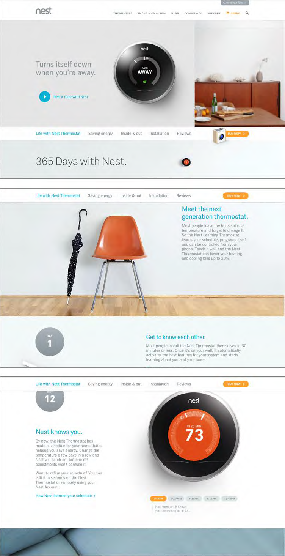
Scrolling

Slide 29
The header and footer
The top, often called the header, can be the first thing the user sees when he arrives on a page.
The header almost always includes a brand element like a logotype, and some persistent navigation items, including the primary navigation (discussed earlier).
The header is also commonly the place where a website or application tells the user whether he or she is signed in.
The search function often resides in the header.

Slide 30
The header and footer
The bottom of the page, or footer, is the user ends up.
All the content that came before it on the page.
This makes it a great place to suggest where the user should go next—often to related content.
Another effective use of the footer is for persistent access to more rarely visited areas of your site or application.

Slide 31
The header and footer

Slide 32
The header and footer
What should be considered?
the circumstances under which your users might need access to these links.
whether you imagine they’ll be web-savvy enough to scroll to the bottom of the page to look for them.

Slide 33
Paging vs. infinite scrolling
Infinite scrolling
As the user scrolls down the page, the page populates more results into the bottom.
Paging
a predefined number of results are shown on a page, and navigational links are supplied so that the user can advance to the next or previous page, as well as (typically) the beginning or end of the results, or to an arbitrary page of results.

Slide 34
Paging vs. infinite scrolling
Infinite scroll and site footers are mutually exclusive idioms.
if you implement infinite scrolling, your users will never get to the bottom of the page and therefore will never see the page footer.
Infinite scrolling can introduce other potential usability challenges
Keyboard and screen-reader navigation typically does not work well (if at all) with infinite scrolling
infinite scrolling may not retain its place in the list after use of the browser back button

Slide 35
Paging vs. infinite scrolling
Infinite scrolling most appropriate for contexts such as news feeds, where information far down in the list quickly loses its relevancy, and browsing recent items is the primary activity.
Infinite scrolling should never be employed for interfaces in which users need to get to the end of the list quickly, or need to return to a particular list item after navigating elsewhere.

Slide 36
The Mobile Web
Designers focus on designs render gracefully and properly on a wide variety of screen sizes.
Responsive design
creating a modular layout grid in which content areas flexibly resize up to a point.
If you have only one version of your site, make it responsive.
The basic idea with responsive design is not to have multiple versions of a website or application for different screen sizes, but a single version that dynamically adapts to the screen on which it’s being viewed.
Notes:
P509(539/722)

Slide 37
The Mobile Web
An alternative (and, sometimes, more effective) approach is to create a separate mobile version of the site or application.

Slide 38
Chapter 6 Interaction Design
Thank you！

